Slide 1


SKIN CANCER
Detection
USING AI

Slide 2

MEET THE TEAM
DIVITH PHOGAT CB.EN.U4.AIE20013
PALETI NIKHIL CHOWDARY CB.EN.U4.AIE20046
G. KRISHNA RAYALU CB.EN.U4.AIE20016
S.K. ESWAR SUDHAN CB.EN.U4.AIE20015

Slide 3
CANCER DETECTION
Skin cancer is the most common type of cancer in humans and kills many people every year due to malignant skin lesions
Standard screening methods such as radiological imaging can miss signs of cancer, or return a false negative (as it does in 20-30% of cases).
Hereditary testing
Detecting cancer might be AI’s most altruistic and convoluted challenge yet.
AI can not only greatly improve the accuracy of image detection for cancer, but could also open up entirely new fields between genomics and cancer screening.

Slide 4
AI in cancer classification
New methods are being continuously worked on to detect cancer in its early stages. The later a tumour is detected, the lesser the chances of survival of the patient.
Accuracy of this paradigm surpasses doctor’s accuracy with ease.
Often CNNs (Convolutional Neural Networks) outperform real doctors in detecting cancer from images. CNNs specialize in imagine classification and object detection and are employed in various ways.

Slide 5
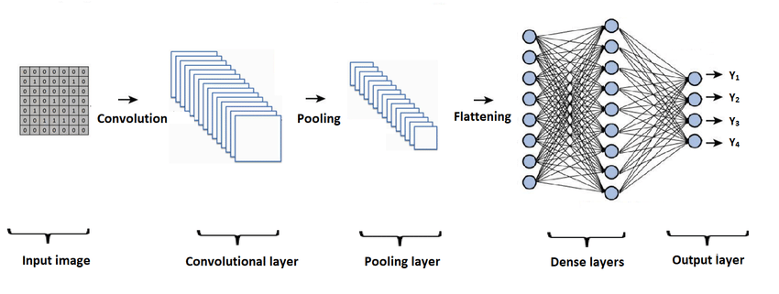
CNN
In deep learning, a convolutional neural network(CNN) is a class of deep neural networks, most commonly applied to analyzing visual imagery.
CNNs are great feature detectors, and hence can be used to identify different types of cancers, and even the different stages of cancer

Slide 6
Accuracy of a cnn
Researchers at Stanford were able to successfully classify skin cancers using CNNs at an accuracy of 72%, whereas human dermatologists had an average accuracy of roughly about 65%.
Though 72% may not sound like a lot, but considering the jump from 65%, these are great statistics.

Slide 7
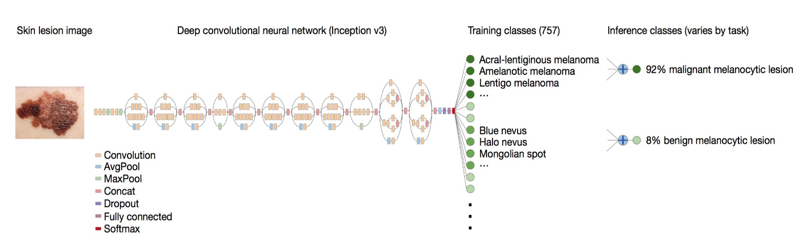
Using AI to detect skin cancer
Skin cancer, the most common type of cancer in humans, is primarily diagnosed visually, beginning with an initial clinical screening and followed potentially by dermoscopic analysis
Automated classification of skin lesions using images is a challenging task owing to the fine-grained variability in the appearance of skin lesions. The following diagram shows the CNN used by Stanford researchers:

Slide 8
SCOPE FOR WIDESPREAD USAGE
Professional healthcare is often not affordable, and sometimes not even accessible to some. We need a cheaper, more effective and far-reaching methods to provide these necessary facilities to people.
Mobile devices like smartphones and smartwatches are some of the most easily accessible devices for people. They can be used for this purpose.
Outfitted with deep neural networks, mobile devices can potentially extend the reach of dermatologists outside of the clinic. It is projected that 6.3 billion smartphone subscriptions will exist by the year 2021 and can therefore potentially provide low-cost universal access to vital diagnostic care.

Slide 9
Though neural networks take a lot of time to train, it doesn’t take as long to process outputs once trained.
Hence it is a feasible idea for such technology to be available right in our pockets.

Slide 10
Current Problems
People do not trust technology easily. Telling someone that they do not need to go to a doctor anymore and can simply get diagnosed with their smartphone sounds like a fantastical idea, almost as if out of a sci-fi movie and hence is difficult to accept by the masses.
Many people simply do not know how to operate these everyday devices that can help diagnose tumours.
Only when these problems can be efficiently countered, can we help reduce the deaths of humans by cancer drastically

Slide 11
OUR RESPONSE
We have built a custom CNN to acknowledge this problem. The CNN is trained on hundreds of images of 3 types of skin cancer:
Nevus
seborrheic keratosis
Melanoma
Nevi and Seborrheic Keratosis are benign, but Melanomas are malignant in nature and are the deadliest form of skin cancer according to our current knowledge
To detect these cancers early, we made a multi-class convolutional neural network classifier. It looks at an image of a tumour and predicts the type

Slide 12
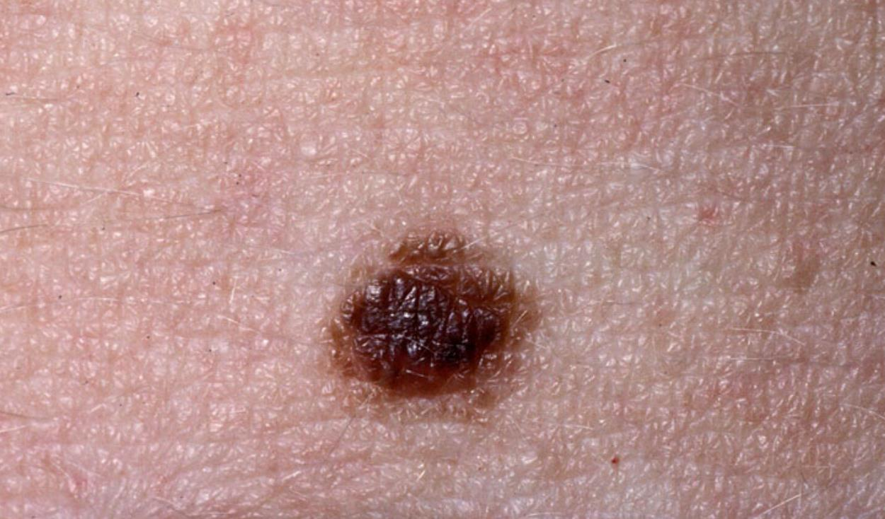
Nevus
Nevus (plural: nevi) is the medical term for a mole.
Nevi are very common.
Common nevi are harmless collections of colored cells.
They typically appear as small brown, tan, or pink spots
You can be born with moles or develop them later.
Moles that you’re born with are known as congenital moles. However, most moles develop during childhood and adolescence. This is known as an acquired nevus. Moles can also develop later in life as a result of sun exposure.

Slide 13
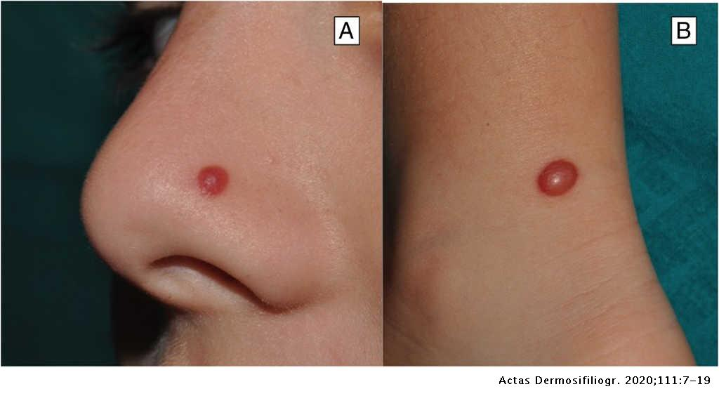
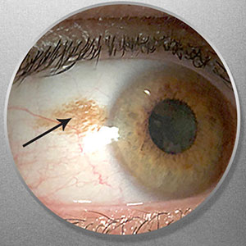

Slide 14
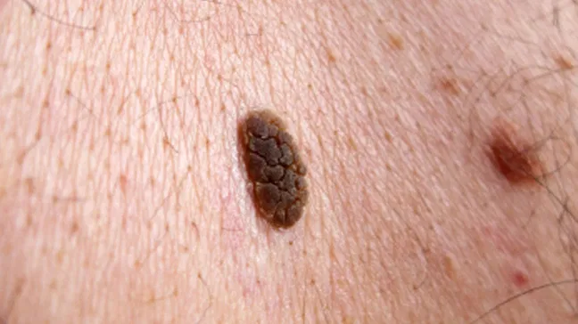
Seborrheic Keratosis
A seborrheic keratosis is a common non cancerous skin growth.
People tend to get more of them as they get older.
Seborrheic keratoses are usually brown, black or light tan.
The growths look waxy, scaly and slightly raised.
They usually appear on the head, neck, chest or back.
Seborrheic keratoses are harmless and not contagious.
They don't need treatment.

Slide 15
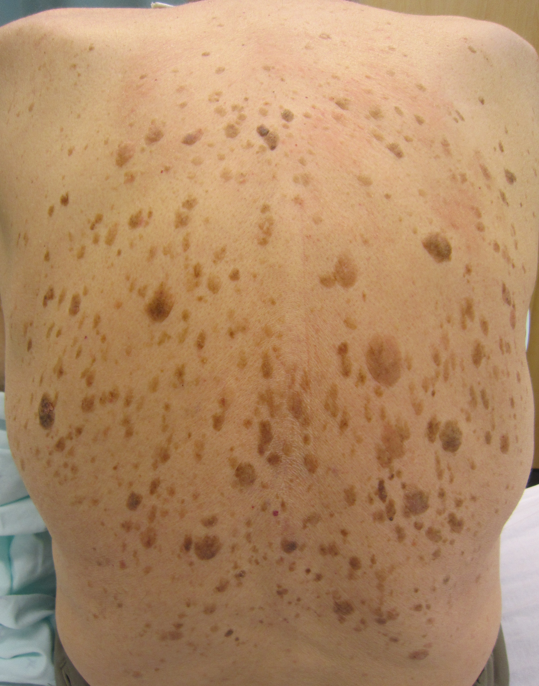

Slide 16
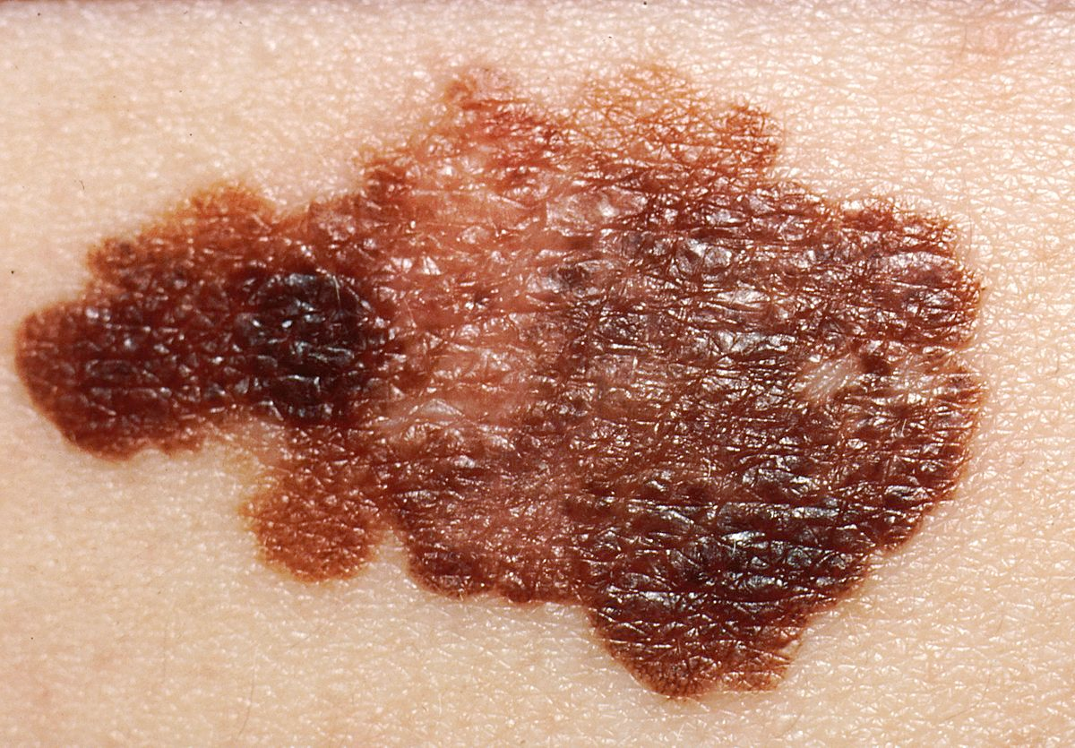
Melanoma
Melanoma, the most serious type of skin cancer, develops in the cells (melanocytes) that produce melanin — the pigment that gives your skin its color. Melanoma can also form in your eyes and, rarely, inside your body, such as in your nose or throat.
The exact cause of all melanomas isn't clear, but exposure to ultraviolet (UV) radiation from sunlight or tanning lamps and beds increases your risk of developing melanoma. Limiting your exposure to UV radiation can help reduce your risk of melanoma.
The risk of melanoma seems to be increasing in people under 40, especially women. Knowing the warning signs of skin cancer can help ensure that cancerous changes are detected and treated before the cancer has spread. Melanoma can be treated successfully if it is detected early.

Slide 17
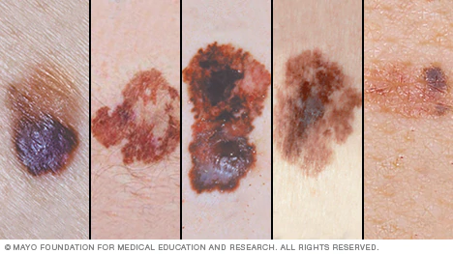

Slide 18
Computational part

Slide 19


Slide 20


Slide 21


Slide 22


Slide 23


Slide 24


Slide 25


Slide 26


Slide 27


Slide 28
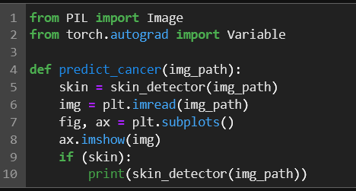

Slide 29
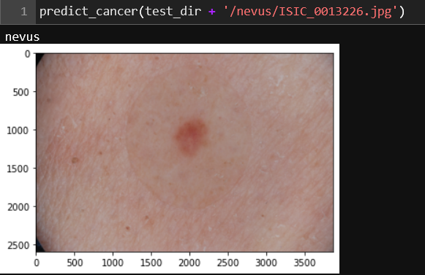

Slide 30
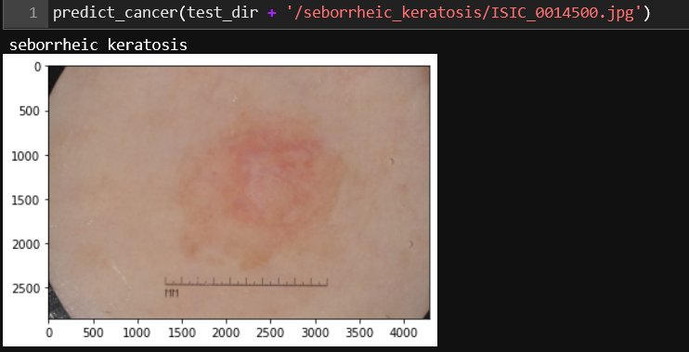

Slide 31
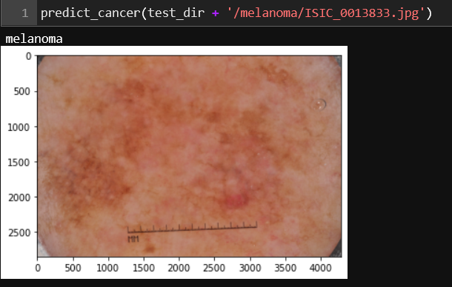

Slide 32
THANKS!

